Slide 1
My BANK BANKING APPLICATION
TEAM : FINANCE TITANS
MODULE : PAYMENT TRANSFER

Slide 2
Agenda
Introduction
Features
Architecture Diagram
DB design
Flow Diagram
Jar file and git hub links

Slide 3

INTRODUCTION
The payment transfer module is a fundamental component within financial systems, enabling the movement of funds between accounts. This includes transfers within the same financial institution or between different institutions, as well as processing different types of payments like one-time, recurring, and scheduled payments.

Slide 4
Features
Display Payee Details
Description: Users have the ability to access payee details by entering their account number.
Functionality: Retrieves payee information from the system's database based on the provided account number. If the account number is not there it will display appropriate message.

Slide 5
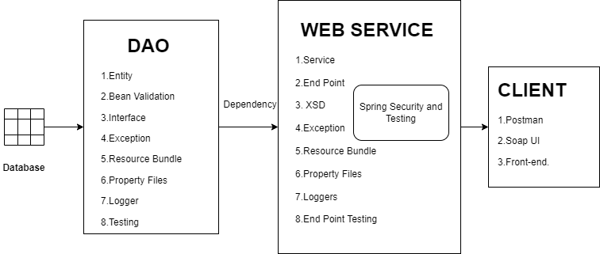
ARCHITECTURE DIAGRAM

Slide 6
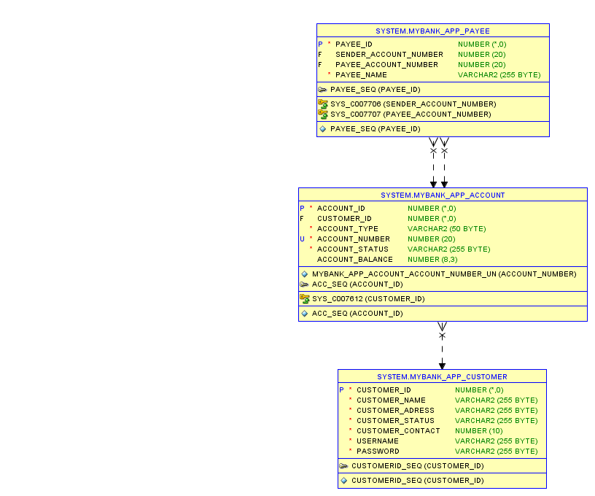
DB DESIGN

Slide 7
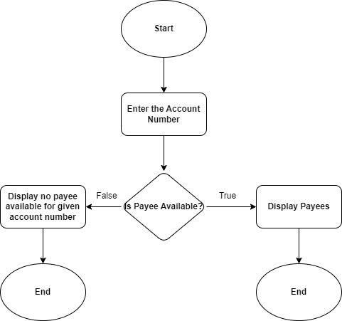
DATAFLOW DIAGRAM​

Slide 8
Second Module (DELETE PAYEE)
Entering the payee details which includes payee id, payee account number, sender account number and payee name.
If the payee exists then delete payee.
If payee not exists it display an appropriate message

Slide 9
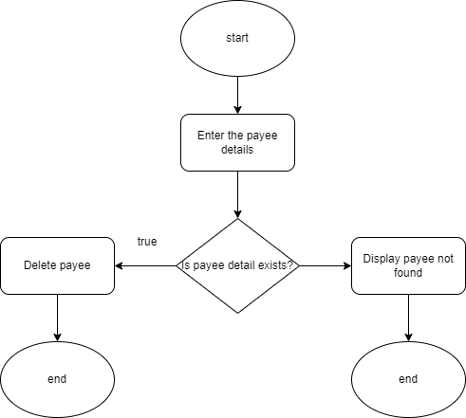
Module 2 DATAFLOW DIAGRAM

Slide 10
LINKS
Git Hub :https://github.com/Arundhathi-Nayak/DLTE-JAVA-FULL-STACK-ARUNDHATHI-NAYAK-2024/tree/master/PROJECT
Jar Files :
DAO : payment-0.0.1-SNAPSHOT.jar
Web Service : webservice-0.0.1-SNAPSHOT.war

Slide 11
THANK YOU

